Slide 1

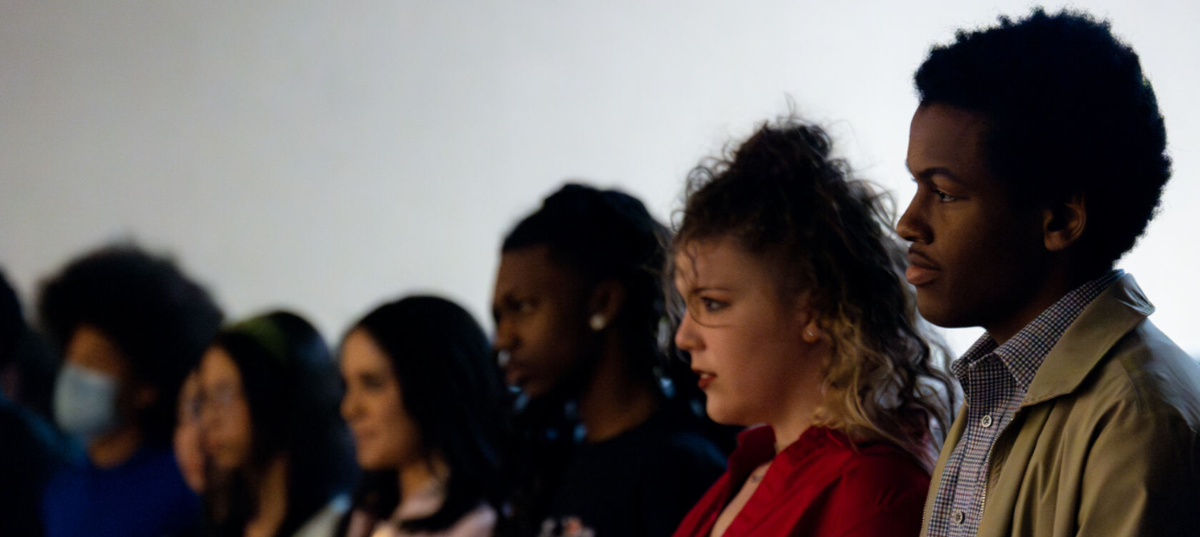


Poetry Out Loud
Georgia // 2025-2026

Slide 2

Welcome // Georgia Council for the Arts
GCA Mission
To cultivate the growth of vibrant, thriving Georgia communities through the arts.
GCA Goals
Expand economic development opportunities through the arts
Grow GCA’s services to new audiences and communities
Utilize arts to fortify education in the state
Strengthen the arts sector
gaarts.org
GCA is a strategic arm of the Georgia Department of Economic Development (GDEcD), the State of Georgia's marketing and sales arm.

Slide 3
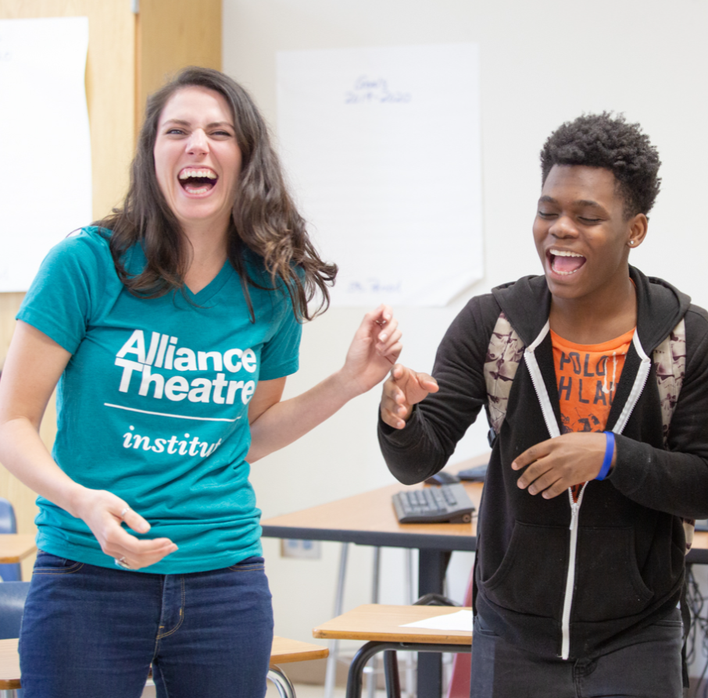
Welcome // Alliance Theatre
Mission
The Alliance Theatre is Atlanta’s national theater, expanding hearts and minds onstage and off.
Program Goals
The Alliance delivers powerful programming that challenges adult and youth audiences to think critically and care deeply.
Institute
A branch of the organization's robust education department, the Alliance Theatre Institute partners with school districts and schools to deliver professional learning for educators and arts integrated or theater-based instruction for students.

Slide 4
What is Poetry Out Loud?
Poetry Out Loud® lifts poetry off the page, creating community and connection. Since the program began in 2005, more than 4.5 million high school students have participated in this dynamic poetry recitation competition. Poetry Out Loud can help students improve public speaking skills, build confidence, and grow their appreciation for poetry.
In recognition of America’s 250th anniversary in 2026, the 2025-2026 Poetry Out Loud program will focus on poems that celebrate the rich tapestry of American history and culture.
An updated list of poems for this year’s competition is available at PoetryOutLoud.org.
An initiative of the National Endowment for the Arts, Poetry Out Loud is administered at the state level by the state and jurisdictional arts agencies and free educational materials for teachers and organizers. Poetry Out Loud is managed in partnership with Mid Atlantic Arts.

Slide 5
Poetry Out Loud Structure
Local Contests
occur at registered school & community sites
deadline: by Friday, January 23
Regional Contests
in-person on Friday, February 6 and/or Saturday, February 7
virtual on Tuesday, February 10
details to be announced
State Final
occur on the Alliance Theatre's Goizueta Stage for Youth & Families on Friday, March 6
details to be announced
National Finals
occur in Washington, DC
from Monday, April 27 –
Wednesday, April 29
administered by the NEA
Important Dates & Deadlines
Early January 2026: Regional Contest details (dates, times, locations) to be announced (informed by registration data)
Friday, January 16 (11:59 PM): Registration for Georgia Schools & Organizations closes
Friday, January 23 (11:59 PM): Deadline for Georgia Schools & Organizations to hold a local contest and report a champion

Slide 6
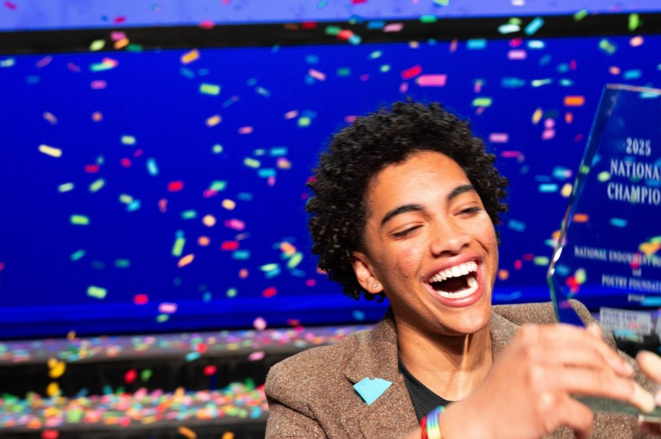
National Guidelines & Resources
Visit: PoetryOutLoud.org
Find poems (anthology)
Resources for students (tips & videos)
Resources for teachers and organizers (guide, lesson plans, impact study)
Resources for judges (guide, score sheets, criteria, and tips)
Guidance on Frequently Asked Questions

Slide 7
Student Workshops
Preparation for Regional Contests
💻 Virtual: Saturday, January 31 @ 10 AM – 12 PM (Live; via Zoom)
Preparation for State Final
💻 Virtual: Saturday, February 14 @ 10 AM - 12 PM (Live; via Zoom)
Workshops will orient students to next steps & address Evaluation Criteria:
Physical Presence
Voice and Articulation
Interpretation
Evidence of Understanding
Overall Performance
Accuracy

Slide 8
Prizes // State & National
State Level:
$200 for each first-place winner
$500 for poetry materials for each first-place winner’s school or organization
$100 for one runner-up in each state
$200 for the purchase of poetry materials for each runner-up’s school or organization
National Level:
$20,000 for the National Champion
$10,000 for 2nd place
$5,000 for 3rd place
$1,000 for 4th–9th places
Representing schools/organizations of top nine finalists receive $500 for the purchase of poetry materials.
One honorable mention in each of the three national semifinal competitions – those students will not advance to the finals, but will each receive a $1,000 cash award and a $500 stipend for their school/organization.
Note:
Mid Atlantic Arts provides and administers all aspects of the monetary prizes awarded and travel arrangements to the Poetry Out Loud National Finals.

Slide 9

Questions + Discussion

Slide 10
Contact
Liz Davis, Producer
Head of Secondary Curriculum and Partnerships
liz.davis@alliancetheatre.org
Katie Wolff, Associate Producer
Institute Program Coordinator
katie.wolff@alliancetheatre.org
General Inquiries
poetryoutloud@alliancetheatre.org
Emily Yewell Volin
Grants and Arts Education Program Manager
EVolin@Gaarts.org

